Slide 2

GASTROINTESTINAL
ENDOSCOPIC IMAGES
CLASSIFICATION
Students:
Do Thi Khanh Linh – 20182963
Ho Nguyen Khang – 20182958
Instructor:
Assc. Prof. Tran Thi Thanh Hai

Slide 3
OUTLINE
1. Subject topic
2. Contribution of each member
3. Algorithms & Dataset
4. Programming Technique
5. Results

Slide 4
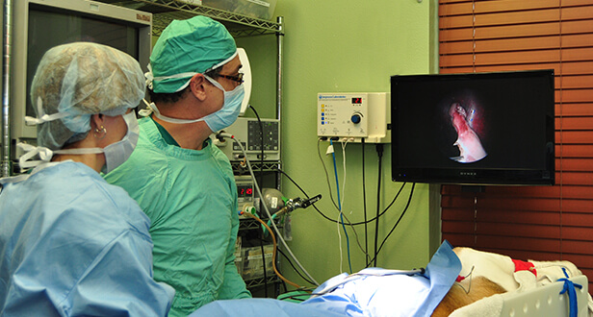
1. SUBJECT TOPIC
Reasons for choosing this topic​
Endoscopic examinations are the gold standards for investigation of the GI tract. However, the ability to detect adenomas varies between doctors, and this may eventually affect the individuals’ risk of getting colorectal cancer.
​
For automatic algorithmic detection of abnormalities using AI in the GI tract, there have been many proposals from various research communities, especially for the topic of polyp detection.

Slide 5
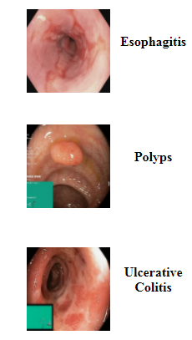

1. SUBJECT TOPIC
Purpose
Achieve a model consisting of simple algorithms to process as input images from different phatological findings, and as output - they are classified into the correct class.​
Classification
Our abstract about endoscopic images classification presents the implementation of the C++ programming language and the Open CV library​

Slide 6
2. CONTRIBUTIONS OF EACH MEMBER
Task ID | Task Name | Resource Name
#1 | Doing overall research & create plans | All members
#2 | Doing research about gastrointestinal endoscopic image database. | Do Thi Khanh Linh
#3 | Read image’s data. | Do Thi Khanh Linh
#4 | Extracting image’s feature using Histogram of Oriented Gradient algorithm. | Do Thi Khanh Linh
#5 | Doing the calculation of the distance function. | Ho Nguyen Khang
#6 | Implementing the KNN algorithm to determine the image's class. | Ho Nguyen Khang
#7 | Making Report + Slide + Defend Project | All members

Slide 7
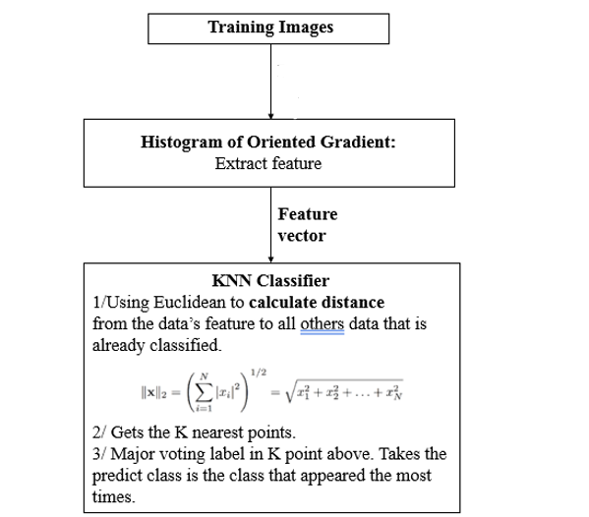
3. ALGORITHMS & DATASET

Slide 8
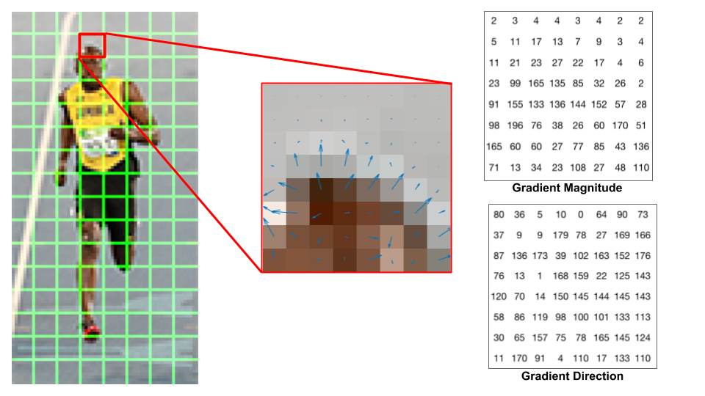
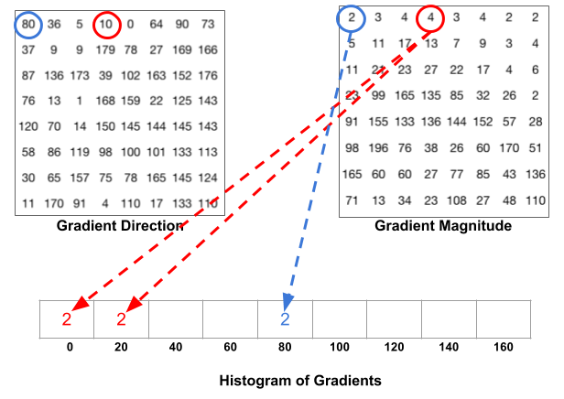
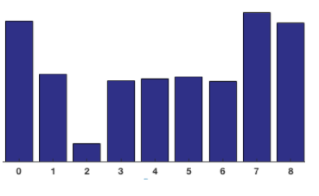
3. ALGORITHMS & DATASET
Feature Extraction – Histogram of Oriented Gradient
Image features, such as edges and interest points, provide rich information on the image content.
HOG descriptor focuses on the structure or the shape of an object. HOG is able identify if the pixel is an edge and edge direction as well.
HOG extracting the gradient and orientation (magnitude and direction) of the edges.
Image is broken down into smaller regions and for each region, the gradients and orientation are calculated.
Finally the HOG would generate a Histogram for each of these regions separately. The histograms are created using the gradients and orientations of the pixel values.

Slide 9
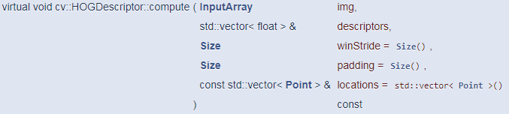
3. ALGORITHMS & DATASET
HOG implementation in OpenCV
cv::HOGDescriptor Struct #include <opencv2/objdetect.hpp>
More specifically, we use member function compute() to computes HOG descriptors of given image.
Parameters
img Matrix of the type CV_8U containing an image where HOG features will be calculated.
descriptors Matrix of the type CV_32F
winStride Window stride. It must be a multiple of block stride.
padding Padding
locations Vector of Point

Slide 10
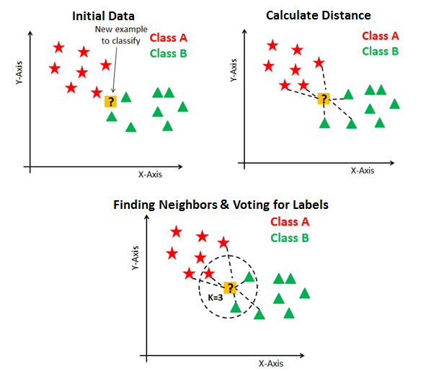
3. ALGORITHMS & DATASET
KNN – K Nearest Neighbors Classifier
KNN suggests it considers K Data points to predict the class or continuous value for the new Datapoint.
Suppose P1 is the point, for which label needs to predict. First, find the k closest point to P1 and then classify points by majority vote of its k neighbors. Each object votes for their class and the class with the most votes is taken as the prediction. For finding closest similar points, you find the distance between points using distance measures such as Euclidean.
KNN has the following basic steps:
1. Calculate distance.
2. Find closest neighbors.
3. Vote for labels.

Slide 11
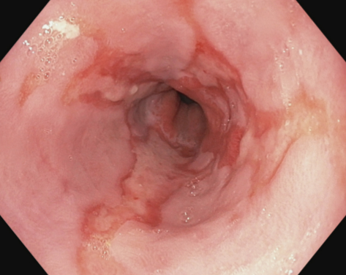
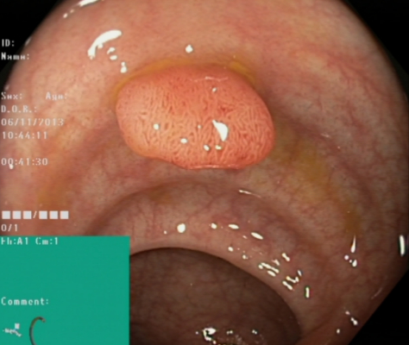
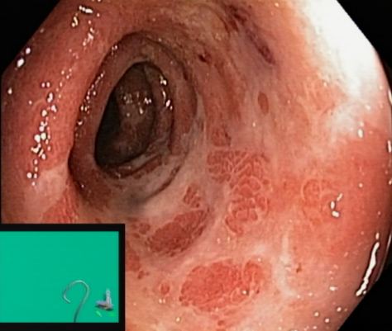
3. ALGORITHMS & DATASET
Dataset preparation: The Kvasir Dataset (simula.no)
Data Collection:
The data is collected using endoscopic equipment at Vestre Viken Health Trust (VV) in Norway and are carefully annotated by medical experts from VV and the Cancer Registry of Norway (CRN).
Our data usage:
We want to classify input images to different phatological findings: Esophagitis, Polyps and Ulcerative Colitis.
A pathological finding in this context is an abnormal feature within the gastrointestinal tract.
Endoscopically, it is visible as a damage or change in the normal mucosa
signs of an ongoing disease or a precursor to for example cancer.
Esophagitis
Polyps
Ulcerative Colitis

Slide 12
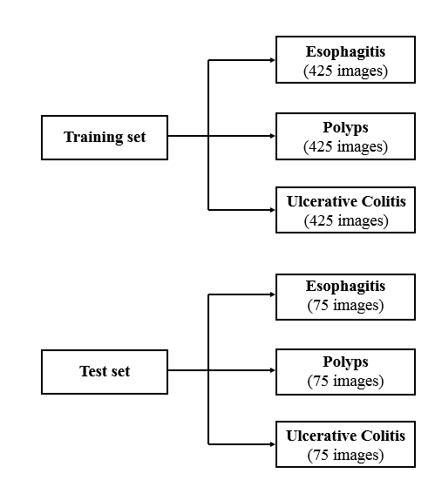
3. ALGORITHMS & DATASET
Our data usage

Slide 13
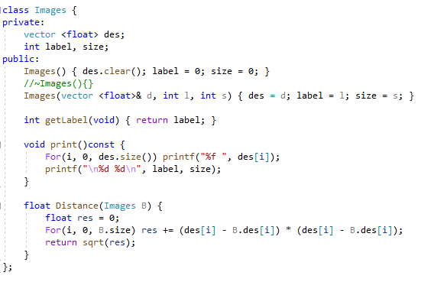
4. PROGRAMMING TECHNIQUE
Notes:
For Programming Technique, we want to use Object Oriented Programming so we wrote Class Image with private data member, which include vector des for ... , and 2 interger data member label and size. In public part, we wrote Default Constructor and Copy Constructor to initializing data member of Image. Moreover, we wrote function getLable, print and distance to get the corresponding work.

Slide 14
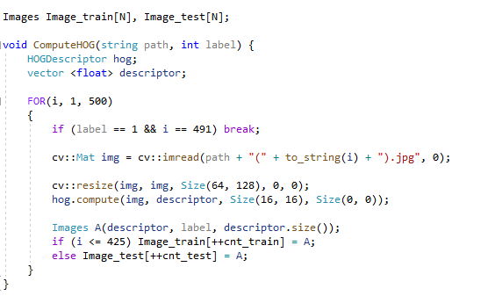
4. PROGRAMMING TECHNIQUE
Notes:
For HOG implementation, we write a Function Compute HOG that include defined hog of HOGDescriptor and a vector descriptor. We will work with those vector to get the data of input images, by “im read” sentence. Before we use compute function, we resize image first.......

Slide 15
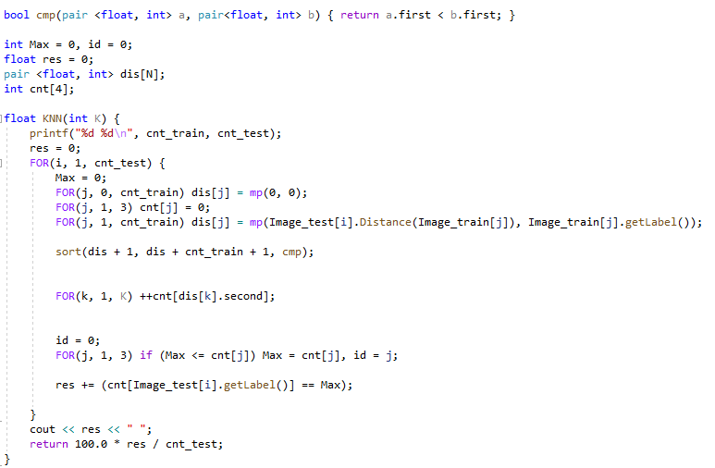
4. PROGRAMMING TECHNIQUE
Notes:
For KNN algorithms, we wrote it like this... We compute distance between... And if

Slide 16
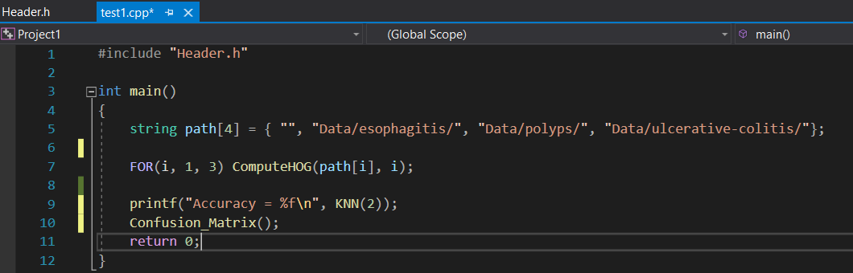
4. PROGRAMMING TECHNIQUE
Notes:
After that, we put all of above code into 1 file called Header, and use it as an library. So that you can see in main function, we easily call function ComputeHOG to get the feature from image data.

Slide 17
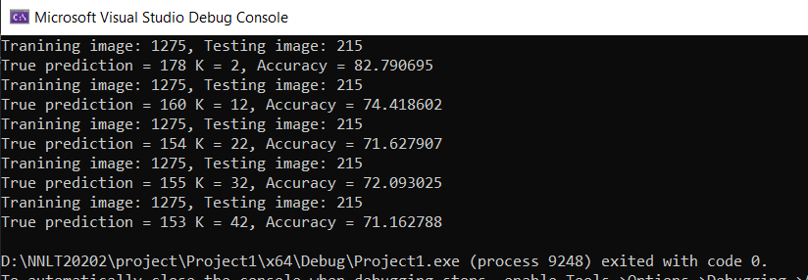
4. PROGRAMMING TECHNIQUE
KNN with K = 2 give us the best result. Accuracy = 82.79%
Increasing K will reduce accuracy (fig. below)
Result of KNN implementation with different K values

Slide 18
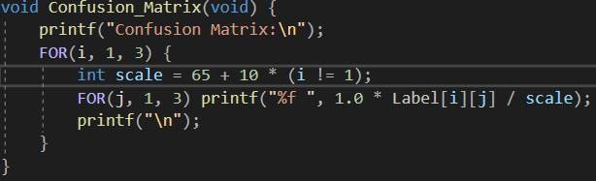
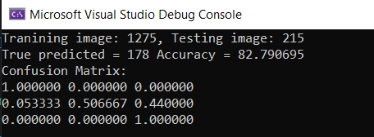
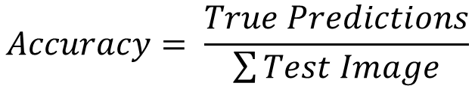
5. RESULT
$$Accuracy= \frac{True Predictions}{\sum{Test Image}}$$
Notes:
To evaluate our result, we use confusion matrix and accuracy. This is our results.

Slide 19
REFERENCES
Tran Thi Thanh Hai, Lecture Slides (C/C++ Programming Language).
Kvasir Dataset: The Kvasir Dataset (simula.no)
Struct HOGDescriptor in OpenCV:
OpenCV: cv::HOGDescriptor Struct Reference
Histogram of Oriented Gradients basic learning:
Histogram of Oriented Gradients explained using OpenCV (learnopencv.com)
Tìm hiểu về hog(histogram of oriented gradients) (viblo.asia)
Feature Descriptor | Hog Descriptor Tutorial (analyticsvidhya.com)
KNN Algorithms basic learning:
KNN Classification using Scikit-learn - DataCamp
KNN Algorithm | What is KNN Algorithm | How does KNN Function (analyticsvidhya.com)

